Slide 1

MEDIA CONSUMTION PATTERN AT FACEBOOK FOR THE AGE GROUP 18-25
Name-sabyasachi singha
Roll-10400917065
Registration no - 171040710100

Slide 2
introduction
What Is Marketing?
The term "marketing" covers a lot of different activities -- all associated with selling your company's products and services. Advertising is the most obvious marketing activity, but so is consumer research, which better matches your product to consumer wants and needs. Product design, also, is a form of marketing, as it helps match your company's products and services to known customer needs.
What is marketing Research?
Marketing research is "the process or set of processes that links the producers, customers, and end users to the marketer through information used to identify and define marketing opportunities and problems; generate, refine, and evaluate marketing actions; monitor marketing performance; and improve understanding of marketing as a process. Marketing research specifies the information required to address these issues, designs the method for collecting information, manages and implements the data collection process, analyses the results, and communicates the findings and their implications."

Slide 3
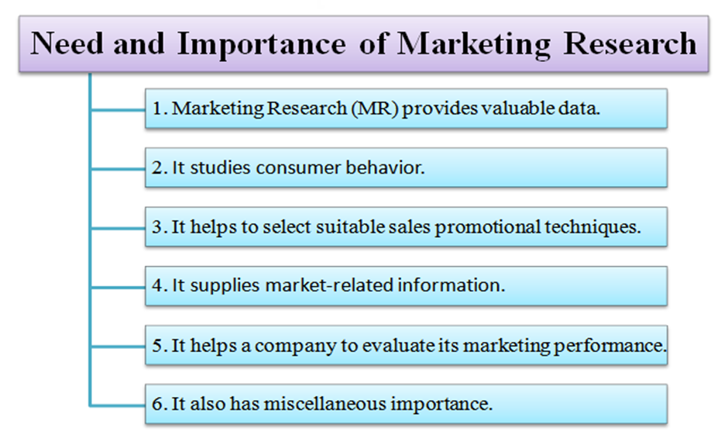

Slide 4
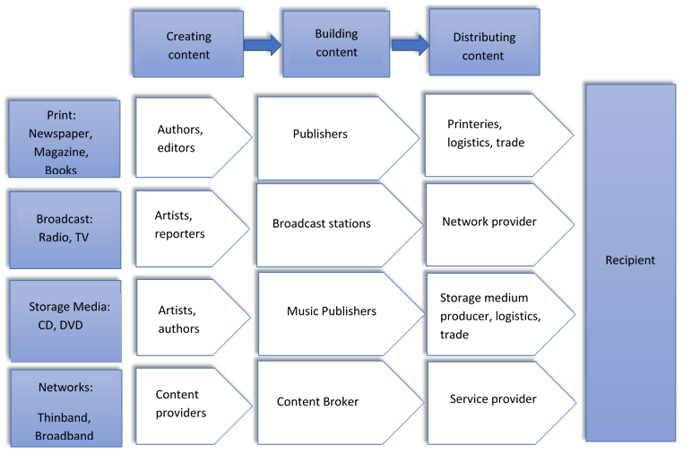
INDUSTRY OVERVIEW

Slide 5
Objectives of the study:
Research objectives are to find out viewer’s choice, consumption pattern, their demand, which types of movies should the channel show in their channel & which type of content should the channel post at their Facebook page to attract the viewers of age group 18-25.

Slide 6
Methodology in brief:
Research type-exploratory
Data collection tool – primary research tool
1st step: We have made 31 questions. Among them we have selected 18 questions to reach our objectives.
2nd step: We made a questionnaire of 18 questions.
3rd step: After this I went to different colleges of different districts to fill that questionnaire. I have visited five colleges from each district (Howrah, Kolkata, North 24 PGS) to collect those informations. My total sample size was 238.
4th step: After collecting those informations I have done some analysis to understand the viewers consumption pattern for the age group 18-25.
5th step: At the last step I have found some major points & on the base of that. After that I have given some recommendations.

Slide 7
WHICH TYPE OF PLATFORM viewers ARE USING

Slide 8
WHICH TYPE OF PLATFORM viewers ARE USING MOST

Slide 9
WHICH TYPE OF PHONE viewers ARE USING

Slide 10
VIEWERS ARE USING FACEBOOK FROM

Slide 11
HOW FREQUENTLY VIEWERS COME ON FACEBOOK (HOW MANY TIMES IN A DAY)
 | MASTER | HOWRAH | KOLKATA | NORTH 24 PGS
SAMPLE | 216 | 54 | 80 | 82
AVERAGE | 6-7 | 7-8 | 7-8 | 5-6

Slide 12
HOW MANY FRIENDS DO VIEWERS HAVE IN FACEBOOK
 | MASTER | HOWRAH | KOLKATA | NORTH 24 PGS
SAMPLE | 229 | 57 | 90 | 82
AVERAGE | 800 | 630 | 824 | 900

Slide 13
DO VIEWERS WATCH MOVIES
 | MASTER | HOWRAH | KOLKATA | NORTH 24 PGS
TOTAL SAMPLE | 238 | 61 | 91 | 84
YES | 236 | 60 | 91 | 84
NO | 1 | 1 | 0 | 0
99.16 % people love to watch movies.

Slide 14
MENTION WHAT VIEWERS HAVE SEEN LAST
TOTAL SAMPLE = 239
AMONG THEM 224 (93.72%) VIEWERS ARE USING FACEBOOK AND YOUTUBE MOSTLY.
AMONG 224 VIEWERS 223 ( 99.55% ) VIEWERS ARE WATCH MOVIES.
AMONG 223 VIEWERS 122 ( 54.70% ) VIEWERS HAVE SEEN BENGALI MOVIES & 89 (39.91%) HAVE SEEN HINDI OR ENGLISH MOVIES.
IF WE CONSIDER THOSE VIEWERS WHO LIKE TO SEE VIDEOES THEN WE WILL GET,
AMONG 223 VIEWERS 178 (79.82%) VIEWERS LIKE TO SEE VIDEOES AT FACEBOOK.
AMONG THIS 178 VIEWERS 91 (51.12%) VIEWERS WATCHED BENGALI MOVIES AND 76 ( 42.70% ) VIEWERS WATCHED HINDI AND ENGLISH MOVIES.
AMONG 239 VIEWERS 51.05 % VIEWERS HAVE SEEN BENGALI MOVIES. ALL ARE USING FACEBOOK AND YOUTUBE. SOME OF THEM LIKE TO SEE VIDEOS AND SOME OF THEM DON’T LIKE TO SEE VIDEOS.
AMONG 239 VIEWERS 38.07 % VIEWERS HAVE SEEN BENGALI MOVIES ANDTHEY ARE USING FACEBOOK AND YOUTUBE AND THEY ALSO LOVE TO SEE VIDEOS.

Slide 15
TOTAL SAMPLE = 239
AMONG THEM 224 (93.72%) VIEWERS ARE USING FACEBOOK AND YOUTUBE MOSTLY.
AMONG 224 VIEWERS 223 ( 99.55% ) VIEWERS ARE WATCH MOVIES.
AMONG 223 VIEWERS 122 ( 54.70% ) VIEWERS HAVE SEEN BENGALI MOVIES
MOVIE NAME NO OF LAST SEEN MOVIE NAME NO OF LAST SEEN
AMAR APONJON 1 AMAZON ABHIJAN 11
APUR PANCHALI 1 BAKSHO RAHASYA 1
BISORJON 3 BOJHENA SE BOJHENA 1
BOLO DUGGA MAI KI 3 BOSS 2 2
BYOMKESH 3 BYOMKESH O AGNIBAN 1
COCKPIT 2 DRISTOKON 5
HAAMI 16 GANGSTAR 1
GHARE & BAIRE 2 GUPTODHONER SONDHANE 4
MOVIE NAME | NO OF LAST SEEN
AMAR APONJON | 1
APUR PANCHALI | 1
BISORJON | 3
BOLO DUGGA MAI KI | 3
BYOMKESH | 3
COCKPIT | 2
HAAMI | 16
GHARE & BAIRE | 2
MOVIE NAME | NO OF LAST SEEN
AMAZON ABHIJAN | 11
BAKSHO RAHASYA | 1
BOJHENA SE BOJHENA | 1
BOSS 2 | 2
BYOMKESH O AGNIBAN | 1
DRISTIKON | 5
GANGSTAR | 1
GUPTODHONER SONDHANE | 4

Slide 16
MOVIE NAME | NO OF LAST SEEN
HARIPADA BANDWALA | 1
JATISWAR | 1
KELOR KIRTI | 3
MAYURAKHSHI | 2
MISHOR ROHOSYO | 1
CHANDER PAHAR | 1
POSTO | 3
PRAKTON | 3
PROLOY | 2
RATER RAJANI GANDHA | 1
UMA | 21
YETI ABHIJAN | 5
MOVIE NAME | NO OF LAST SEEN
JAKHER DHON | 2
JIO PAGLA | 4
KI KORE TOKE BOLBO | 1
MEGHNAD BODH ROHOSYO | 1
ONE | 1
PAGLU 2 | 2
POWER | 1
PREM BY CHANCE | 1
RAJA RANI RAJI | 2
SAMANTARAL | 1
TOTAL DADAGIRI | 3
ZULFIQAR | 2
MOVIE NAME NO OF LAST SEEN % MOVIE NAME NO OF LAST SEEN %
HARIPADA BANDWALA 1 JAKHER DHON 2
JATISWAR 1 JIO PAGLA 4
KELOR KIRTI 3 KI KORE TOKE BOLBO 1
MAYURAKHSHI 2 MEGHNAD BODH ROHOSYO 1
MISHOR ROHOSYO 1 ONE 1
CHANDER PAHAR 1 PAGLU 2 2
POSTO 3 POWER 1
PRAKTON 3 PREM BY CHANCE 1
PROLOY 2 RAJA RANI RAJI 2
RATER RAJANI GANDHA 1 SAMANTARAL 1
UMA 21 TOTAL DADGIRI 3
YETI ABHIJAN 5 ZULFIQAR 2

Slide 17
IN WHICH DEVICE DO VIEWERS LIKE TO WATCH MOVIES

Slide 18
DO VIEWERS WATCH BENGALI MOVIES
WE HAVE GOTTEN 85.71 % VIEWERS WATCH BENGALI MOVIES.
 | MASTER | HOWRAH | KOLKATA | NORTH 24 PGS | % (MASTER)
TOTAL SAMPLE | 238 | 61 | 92 | 84
YES | 204 | 56 | 73 | 75 | 85.71
NO | 33 | 5 | 19 | 9 | 13.87

Slide 19
WHO IS VIEWERS FAVOURITTE MOVIE STAR
TOTAL SAMPLE = 239
AMONG THEM 224 (93.72%) VIEWERS ARE USING FACEBOOK AND YOUTUBE MOSTLY.
AMONG 224 VIEWERS 223 ( 99.55% ) VIEWERS ARE WATCH MOVIES.
AMONG 223 VIEWERS 222 ( 99.55 % ) VIEWERS WATCH BENGALI MOVIES.
AMONG 222 VIEWERS 127 ( 57.21 % ) VIEWERS MENTIONES BENGALI MOVIE’S ACTOR/ACTRESS NAMES AS THEIR FAVOURITE MOVIE STAR.
AMONG TOTAL SAMPLE 53.14 % VIEWERS MENTIONED BENGALI MOVIE’S ACTOR OR ACTRESS NAMES AS THEIR FAVOURITE MOVIE STAR.

Slide 20
FAVOURITE MOVIE STAR
MOVIE STAR NAMES | NO OF VOTES
ABIR CHATERJEE | 35
PARAMBRATA CHATERJEE | 20
SWASTIKA MUKHERJEE | 2
NUSRAT JAHAN | 3
ARJUN CHAKRABORTY | 2
KANGKANA SEN SHARMA | 2
MIMI CHAKRABORTY | 5
PARNO MITRA | 2
SUBHASHREE GANGULY | 4
SOUMITRA CHATERJEE | 4
UTTAM KUMAR | 1
MOVIE STAR NAMES | NO OF VOTES
JISHU SENGUPTA | 5
PRASENJEET CHATERJEE | 13
ANKUSH HAZRA | 11
JEET | 15
DEV | 16
KOYEL MALLICK | 8
SAYANTIKA BANERJEE | 2
ROBI GHOSH | 1
SOHAM CHAKRABORTY | 4
SWASOTO CHATERJEE | 3
YASH DAS GUPTA | 8
MOVIE STAR NAMES NO OF VOTES MOVIE STAR NAMES NO OF VOTES
ABIR CHATERJEE 35 JISHU SENGUPTA 5
PARAMBRATA CHATERJEE 20 PRASENJEET CHATERJEE 13
SWASTIKA MUKHERJEE 2 ANKUSH HAZRA 11
NUSRAT JAHAN 3 JEET 15
ARJUN CHAKRABORTY 2 DEV 16
KANGKANA SEN SHARMA 2 KOYEL MALLICK 8
MIMI CHAKRABORTY 5 SAYANTIKA BANERJEE 2
PARNO MITRA 2 ROBI GHOSH 1
SUBHASHREE GANGULY 4 SOHAM CHAKRABORTY 4
SOUMITRA CHATERJEE 4 SWASWOTO CHATERJEE 3
UTTAM KUMAR 1 YASH DAS GUPTA 8

Slide 21
ARE VIEWERS FOLLOWING HIM/HER AT FACEBOOK
 | MASTER | HOWRAH | KOLKATA | NORT 24 PGS | % (MASTER)
TOTAL SAMPLE | 235 | 60 | 91 | 83
YES | 156 | 39 | 60 | 57 | 66.38
NO | 78 | 21 | 31 | 26 | 33.19
* 66.38 % VIEWERS ARE FOLLOWING THEIR FAVOURITE MOVIE STAR.

Slide 22
ARE YOU FOLLOWING FACEBOOK PAGE OF ANYOTHER ACTOR OR ACTRESS
WE GOT SOME ACTOR OR ACTRESS NAMES WHOM VIEWERS ARE FOLLOWING BUT THEY ARE NOT IN THEIR FAVOURITE MOVIE STAR LIST.
ACTOR / ACTRESS NAMES
GOURAB CHAKRABORTY
SAYANI GHOSH
OINDRILA SEN
PRIYANKA SARKAR
RITTIKA SEN
SRABANTI
RITUPARNA SENGUPTA
RACHANA BANERJEE
RUDRANIL GHOSH
BONNY SENGUPTA

Slide 23
ARE VIEWERS SUBSCRIBED TO ANY TELEVISION CHANNEL PAGE
TOTAL SAMPLE 239. AMONG THEM 224 VIEWERS ARE USING FACEBOOK AND YOUTUBE MOSTLY.
AMONG 224 VIEWERS 223 VIEWERS WATCH MOVIES.
AMONG 223 VIEWERS 222 VIEWERS WATCH BENGALI MOVIES.
AMONG 222 VIEWERS 88 VIEWERS ARE SUBSCRIBING ANY TELEVISION CHANNEL PAGE.
AMONG 88 VIEWERS 55 VIEWERS ARE FOLLOWING ANY BEANGALI TELEVISION CHANNEL PAGE.
THAT’S MEAN WE HAVE GOTTEN AMONG 239 VIEWERS ONLY 23.01 % VIEWERS ARE SUBSCRIBING ANY BENGALI TELEVISION CHANNEL PAGE.
 | MASTER | HOWRAH | KOLKATA | NORTH 24 PGS | % (MASTER)
TOTAL SAMPLE | 234 | 34 | 90 | 83
YES | 103 | 26 | 36 | 41 | 44.02
NO | 130 | 60 | 54 | 42 | 55.56

Slide 24
CHANNELS (ONLY BANGALI) | NO OF SUBSCRIPTION
24 GHANTA | 10
ABP ANANDA | 20
COLOURS BANGLA | 3
ZEE BANGLA | 16
CHANNEL 5 | 1
JALSHA MOVIES | 5
SANGEET BANGLA | 8
STAR JALSHA | 9
ZEE BANGLA CINEMA | 2

Slide 25
DO VIEWERS LIKE TO SEE VIDEOS AT FACEBOOK
 | MASTER | HOWRAH | KOLKATA | NORTH 24 PGS | % (MASTER)
TOTAL SAMPLE | 234 | 61 | 90 | 82
YES | 188 | 43 | 72 | 73 | 80.34
NO | 45 | 18 | 18 | 9 | 19.34
80.34 % VIEWERS LIKE TO SEE VIDEOS AT FACEBOOK.
TOTAL SAMPLE = 239
AMONG THEM 224 (93.72%) VIEWERS ARE USING FACEBOOK AND YOUTUBE MOSTLY.
AMONG 224 VIEWERS 223 ( 99.55% ) VIEWERS ARE WATCH MOVIES.
AMONG 223 VIEWERS 222 ( 99.55 % ) VIEWERS WATCH BENGALI MOVIES.
69.37 % VIEWERS LIKE TO SEE VIDEOS & THEY ALSO WATCH BENGALI MOVIES .
 | MASTER | HOWRAH | KOLKATA | NORTH 24 PGS | % (MASTER)
TOTAL SAMPLE | 222 | 54 | 67 | 73
YES | 154 | 37 | 55 | 64 | 69.37
NO | 68 | 17 | 12 | 9 | 30.63

Slide 26
WHAT DO VIEWERS do IF THEY LIKE A VIDEO ON FACEBOOK

Slide 27
HAVE VIEWERS SEEN ANY MOVIE TRAILOR AT FACEBOOK
 | MASTER | HOWRAH | KOLKATA | NORTH 24 PGS | % (MASTER)
TOTAL SAMPLE | 235 | 61 | 90 | 83
YES | 172 | 41 | 63 | 68 | 73.19
NO | 62 | 20 | 27 | 15 | 26.38

Slide 28
HAVE VIEWERS SEEN ANY PROMOTIONAL VIDEO OF ZEEBANGLA CINEMA AT FACEBOOK
 | MASTER | HOWRAH | KOLKATA | NORTH 24 PGS | % (MASTER)
TOTAL SAMPLE | 235 | 61 | 90 | 83
YES | 95 | 27 | 38 | 30 | 40.42
NO | 137 | 34 | 52 | 51 | 58.30

Slide 29
Total FINDINGS
VIEWERS ARE USING FACEBOOK AND YOUTUBE MOSTLY. (94.12 % OF TOTAL SAMPLE VIEWERS)
MOST OF THE SAMPLE VIEWERS (94.54 %) ARE USING ANDROID PHONES AND MOST OF THE SAMPLE VIEWERS (76.05%) LOVE TO DO FACEBOOK FROM PHONES.
GENERALLY VIEWERS ARE COMING 6-7 TIMES IN A DAY ON FACEBOOK & THEY HAVE AVERAGE 800 FRIENDS IN THEIR FACEBOOK.
THEY GENERALLY LIKE TO SEE VARIOUS TYPES OF UPDATES AND VIDEOS ON FACEBOOK.WE HAVE GOT 80.34 % VIEWERS LIKE TO SEE VIDEOS AT FACEBOOK. WHEN THEY LIKE ANY VIDEO THEY GENERALLY LIKE TO GIVE LIKE AND ALSO THEY LIKE TO SHARE THAT VIDEOS. 73.19 % VIEWERS HAVE SEEN SOME MOVIE TRAILORS AT FACEBOOK TILL NOW BUT MAXIMUM VIEWERS HAVE NOT SEEN ANY PROMOTIONAL VIDEO OF ZEE BANGLA CINEMA ON FACEBOOK.THEY GENERALLY DON’T LIKE TO SUBSCRIBE TO ANY TELEVISION CHANNEL PAGE AT FACEBOOK BUT THEY LIKE TO FOLLOW THEIR FAVOURITE MOVIE STARS FACEBOOK PAGE & 53.14 % VIEWERS HAVE MENTIONED BENGALI MOVIE ACTOR OR ACTRESS NAMES AS THEIR FAVOURITE MOVIE STAR.
MOST OF THE SAMPLE VIEWERS (99.16 %) LOVE TO SEE MOVIES & AMONG THEM 85 % VIEWERS WATCH BENGALI MOVIES AND THEY MOSTLY LOVE TO SEE MOVIES FROM LAPTOPS AND TELEVISIONS.
AMONG TOTAL SAMPLE VIEWERS 51.01 % VIEWERS HAVE SEEN BENGALI MOVIES RECENTLY & AMONG TOTAL SAMPLE VIEWERS WE HAVE GOT 38.07 % VIEWERS WHO LOVE TO SEE VIDEOS ON FACEBOOK AND HAVE SEEN BENGALI MOVIES RECENTLY. THEY GENERALLY LIKE TO SEE HAAMI,UMA ,AMAZON ABHIJAN TYPE OF GOOD STORY BASED MOVIES.

Slide 30
FACEBOOK WITH OTHER APPS ---------- 94.12 %
FB + YOUTUBE + FB & YOUTUBE WITH OTHER APPS ----------98.74 %
STUDENTS ( AGE – 18-25 ) , LOCATION (HOWRAH,KOLKATA,NORTH 24 PGS)
SMART PHONES – ANDROID
ONLINE – 6-7 TIMES IN A DAY
AVERAGE FRIENDS- 800
LIKE TO SEE AT FACEBOOK – UPDATES AND VIDEOS. 80.34 % VIEWERS LIKE TO SEE VIDEOS
(TYPES- ANIMAL,WILDLIFE,NATURE,SPORTS,COOKENRY,SONG,DANCE,SHORT MOVIES,TRAILOR & MANY MORE)
WHEN THEY LIKE ANY VIDEO THEY GENERALLY GIVE LIKE AND THEY ALSO LOVE TO DO SHARE
MOST OF THE VIEWERS DON’T LIKE TO FOLLOW TELEVISION CHANNEL PAGE
MOST OF THE VIEWERS LIKE TO FOLLOW THEIR FAVOURITE MOVIE STAR’S FACEBOOK PAGE.
( ABIR CHATERJEE,PARAMBRATA SENGUPTA ,JEET,DEV ARE POPULER AMONG THEM)
MOST OF VIEWERS HAVE NOT SEEN ANY PROMOTIONAL VIDEO OF ZEE BANGLA CINEMA AT FACEBOOK.
MOST OF THE VIEWERS WATCH BENGALI MOVIES. THEY GENERALLY LIKE TO SEE HAMMI,UMA,AMAZON ABHIJAN TYPES
GOOD STORY BASED MOVIES.
MOST OF THE VIEWERS LOVE TO SEE MOVIES FROM TELEVISION AND LAPTOPS.

Slide 31
Recommendation:
Zee Bangla cinema should post those type of contents on their Facebook page which viewers from this age group mostly follow.
Most of the viewers of this age group do not follow any television channel page but they love to follow their favorite movie stars’ Facebook page. So, zee Bangla should tag their promotional videos or contents to those pages so that this viewers from this age group can view those contents.
Most of the student love to see UMA, HAAMI, AMAZON ABHIJAN type of good story-based movies, so Zee Bangla Cinema should telecast those type of movies.
Most of the viewers of this age group are active on Facebook and most of them like to watch videos on Facebook. So, zee Bangla cinema should concentrate more on their Facebook page and they should post more attractive contents on their Facebook page.
Viewers of this age group have mentioned some movie stars as their favorite like Abir, Parambrata, Dev, Jeet, Ankush, Koyel. So, zee Bangla cinema should telecast their movies to attract more viewers from this age group.

Slide 32
Conclusions
Businesses, corporations, brands and professionals from all lifestyles depend heavily on Facebook to interact and communicate with their consumers and target audience. The role of inbound marketing is crucial in building a name for your brand or product, and social media lets you exactly do that. The role of inbound marketing is crucial in building a name for your brand or product, and social media lets you exactly do that. An asset like social media marketing is important to build business and engage with potential buyers; hence, brands should understand the difference between personal and business Facebook profiles to communicate professionally. For that, businesses create Facebook pages, which have options like Profile picture, Cover photo, Status, Picture and Video updates, Event Planning and other features like polling. The nature of business is represented by the inclination towards specific features and the way it prefers to interact with its target audience. This allows users to read, communicate and share the information in real time, which in turn lets businesses understand the fondness and leanings of their target audience.zee Bangla cinema is also using Facebook for their movie promotion and campaigning, movie advertising purpose.so we can see from our analysis part that different viewers have different choice different consumption patterns.so our main objective was to know the consumption pattern at Facebook for the age group 18-25.so that zee Bangla cinema can take their future decision about their marketing on the base of this project.

Slide 33
BIBLIOGRAPHY
WWW.ZEEBANGLACINEMA.COM
WWW.GOOGLE.COM
WWW.WIKIPIDEA.COM
WWW.ZEEENTERTAINMENT.COM

Slide 34
Thank You

